Slide 1
Node.js & React
Gal Amouyal

Slide 2
About me
Software Engineer
FullStack Developer
Team leader IBM Trusteer
Active Lecture in John Bryce

Slide 3

Contact
galamouyal88@gmail.com
https://www.linkedin.com/in/gal-amouyal-a8707092/
https://github.com/galamo

Slide 4
Time
9:00
npm start
10:30 – 10:45
Loading Coffee
10:45 – 12:30
Lecture
12:30 – 13:30
lunch
13:30 – 15:00
Lecture
15:00 – 15:20
Sweet Break
15:20 – 16:30
Lecture

Slide 5

Before we start

Slide 6
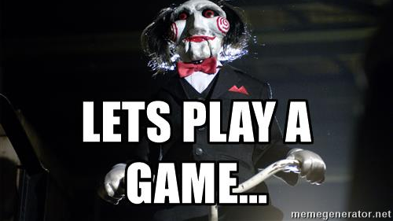

Slide 7
JavaScript Context

Slide 8
Call Stack?

Slide 9
Event Loop ?

Slide 10
V8 Engine?

Slide 11
Questions ?

